Slide 1
Azure FinOps
Introduction

Slide 2
Ze Plan
Introduction
Cases
General Approach
Azure capabilities

Slide 3
Why FinOps?
Organisation spends $70k per month on the cloud
Organisation hires new CTO for building next gen cloud based app
Cloud spending goes up to $300k per month

Slide 4
Sad Stories
Heavy logging
$15k per month, +12 new PostgreSQL, logging for audit purposes +$4k
Mitigation: logging is not auditing, use Change Data Capture for audit, reduce cost for logging ingest
Traffic
Region traffic is free, cross region cost money
Mitigation: package resource close to each other, reduce cross region traffic
Storage
Storage is cheap, however large number of unused VHD becomes an issue.
Notes:
With happy ending

Slide 5
Traditional approval process
Developer needs a thing, she creates a request
Request is approved by a management chain
Accounting pays the bill
Developer gets a thing

Slide 6
Cloud
Developer has keys to the cloud
Developer creates cloud resource
Resources incur charges
Charges get out of control

Slide 7
Potential Risks
Human Mistakes
Wrong Licensing (Developer/Standard/Enterprise)
Lack of responsibility
Pushback, other priorities
Bad Actors
Cryptocurrency mining

Slide 8
Mitigation
Stakeholder alignment
Introduce FinOps culture
Combination of Processes and Technology

Slide 9
Human processes
Stakeholder sponsorship
Separation of responsibilities
FinOps position
Authority
Required Technical & Accounting skills
Request approval process
Governance and Licensing
Continuous Review
Resource Utilization
Resource Necessity
Encourage good behaviour
Notes:
Encourage good behaviour
Department that saved on the cloud may receive additional funding for contractors.

Slide 10
Culture
Introduce the importance from the beginning (onboarding)
Continuously promote sustainability
Encourage resource conservation

Slide 11
Technological processes
Preventive
Azure Blueprints
Azure Policies
Continuous
LMAA
Analysis + Review
Autoscale

Slide 12
Report granularity
Tags can be used to mark resources per Department/Project

Slide 13
LMAA
Collect information
Logging
Analyse
Monitoring
Notify
Alert
Mitigate
Action

Slide 14
LMAA Technologies
Logging
Azure Monitor
Alert
Alert Rule
Action
Alert Rule + Action
Blueprints + Policies
Monitoring
Log Analytics
Application Insights
Budget Alert
Cost Alert

Slide 15
Cost Alert
Budget Alerts
Credit Alerts
Department spending quota

Slide 16
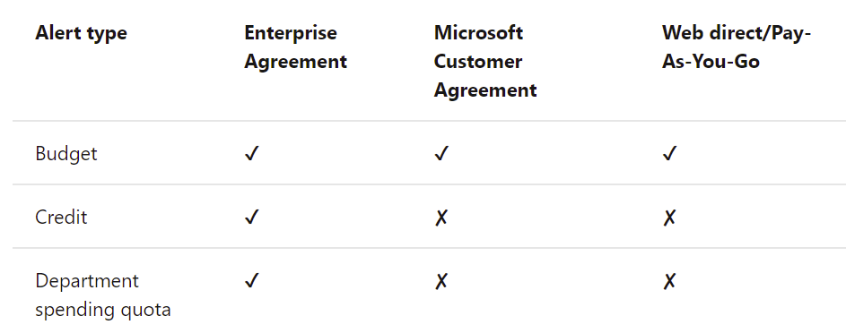
Alert availability per subscription type
Notes:
https://docs.microsoft.com/en-us/azure/cost-management-billing/costs/cost-mgt-alerts-monitor-usage-spending

Slide 17
Per Service Optimizations

Slide 18
Azure SQL Optimizations
Pricing tier
Reservations
Azure SQL Elastic Pool (combine multiple dbs into one)
Scale up / Scale down on schedule
Reduce size of the data (move historical data to archive)
Manual schema/code optimizations

Slide 19
Dev/Test workload optimizations
Visual Studio Subscriptions, Azure Dev/Test
Azure credits
Cheaper resources
Dev/Test licenses
Dev/Test Licenses for SQL Server
Azure Dev/Test
Combines with Azure Reservations for further discounts
Notes:
Why Azure Dev/Test pricing?
https://azure.microsoft.com/en-us/pricing/dev-test/#overview

Slide 20
Azure VM Optimizations
Azure Reservations (1 year, 3 years)
Size optimizations
Scale optimizations
Vertical scale – requires a reboot
Horizontal scale – add/remove VMs as needed
Notes:
What are virtual machine scale sets?
https://docs.microsoft.com/en-us/azure/virtual-machine-scale-sets/overview

Slide 21
Storage optimization
Use Standard HDD for less demanding workloads
Premium HDDs for more demanding workloads
Tiered storage

Slide 22
App Service
Autoscale

Slide 23
Azure Functions – Pricing plans
Consumption
Pay per use
Autoscale
Premium
Pay per use
Higher usage
Dedicated
Dedicated Compute
User Scale
Low usage
Prewarm instances
Autoscale
Notes:
Azure Functions hosting options
https://docs.microsoft.com/en-us/azure/azure-functions/functions-scale#scale

Slide 24
Azure Policies Examples
Limit vCores available for Developers
Limit resources available for creation
Notes:
There are 500+ Azure Services available for creation, it’s easier to disable everything and only allow necessary resources.

Slide 25
Demo Azure Monitor?
Log information
Create Alert

Slide 26
Demo Azure Blueprints and Policies

